Slide 1
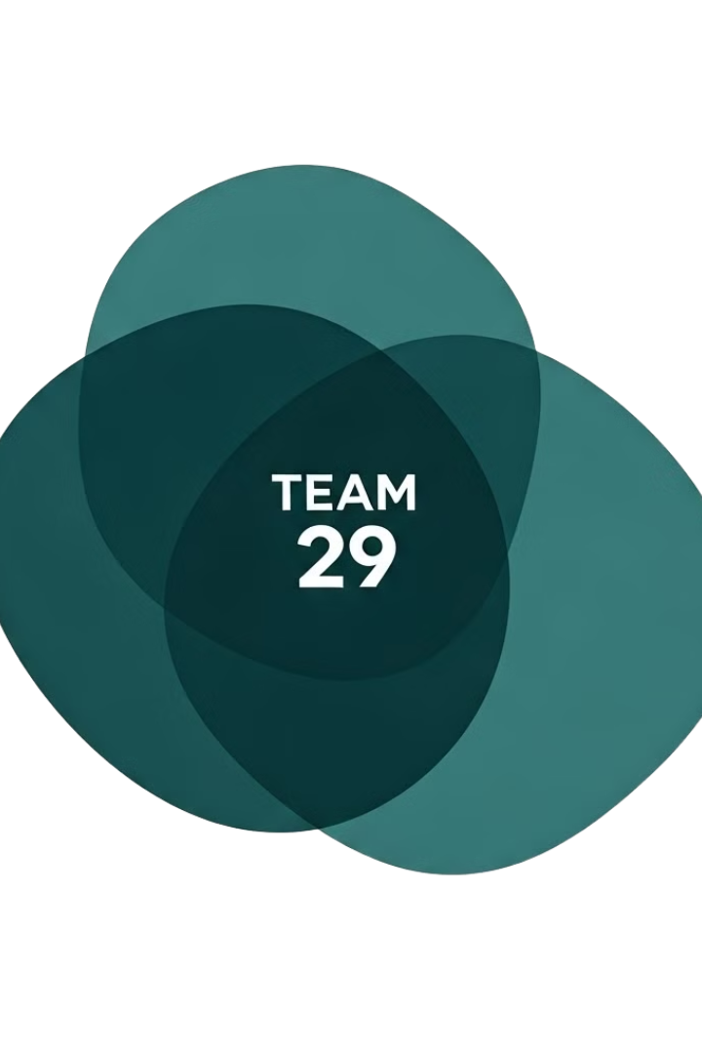

Market Campaign Analysis
Data-driven insights to refine strategies and drive better results!
By, Team 29

Slide 2


Team Members
Fortune Nchetseng
Saahithi
Reddy
Dorothy Nhlapho
Shruthi
Mary
Team Leader
Team Leader
Project Manager
Project Manager
Nontokozo
Mokoena
Pragati
Patel
Teddy
Boamah
Research Specialist
Data Analyst
Data Analyst

Slide 3
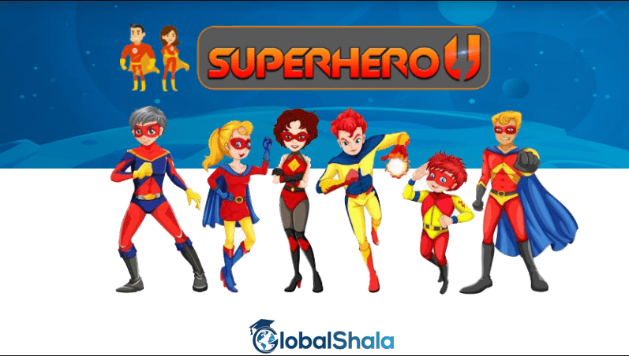

Superhero U
Superhero U event is driven towards instilling a sense of innovation and inventiveness among the youth.

Slide 4

Facebook Ads
Facebook is a social media platform where businesses and individuals can post pictures, videos and engaging content. Businesses such as GlobalShala use Facebook paid ads to promote their ad campaigns for more views and engagement.

Slide 5





Objective of the Analysis :
Assess Campaign Performance
Optimize Budget Allocation
Enhance Audience Targeting
Identify top-performing and underperforming campaigns.
Maximize returns by reallocating
resources effectively.
Focus on high-engagement
demographics and regions.
Boost ROI & Click-Through Rates (CTR)
Provide Actionable Insights
Reduce Cost Per Click (CPC) while increasing engagement.
Drive data-backed decisions for future marketing strategies.

Slide 6
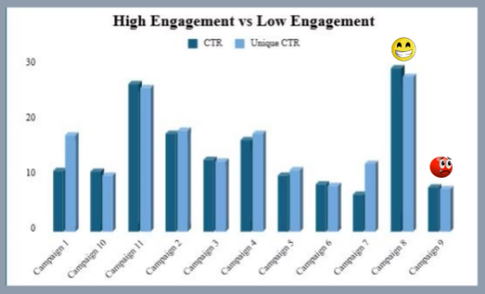
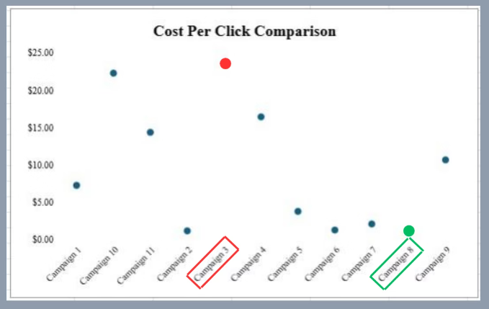
Campaign Engagement & CPC Comparison
High vs. Low Engagement
Top Performers: Campaign 8 & Campaign 11 (Highest CTR & Engagement)
Underperformer: Campaign 9 (Low CTR, low Engagement)
Cost Per Click (CPC) Comparison
Campaign 3 (highlighted in red) has a very high CPC,
making it inefficient.
Campaign 8 (highlighted in green) has the lowest CPC,
making it the best performer.

Slide 7
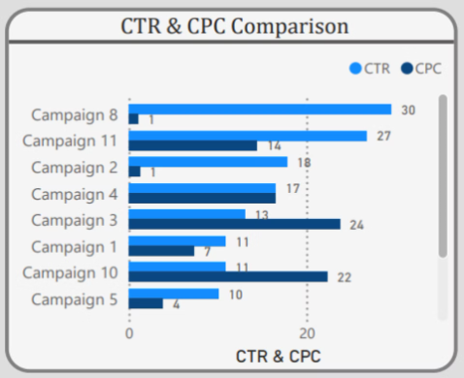
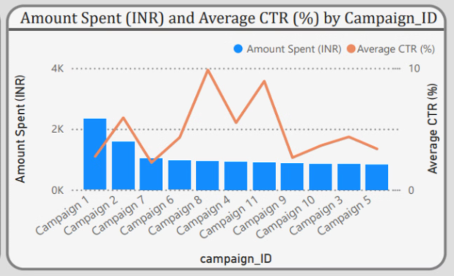
CTR & CPC Comparison
Amount Spent vs. CTR by Campaign
CTR & CPC Comparison
Campaigns with high spending but low CTR should be reviewed for budget reallocation.
Campaign 8, 11, and 2 have the highest CTR.
Campaign 3 and 10 have high CPC, making them inefficient.
Campaign 8 appears to have strong CTR with reasonable spending.

Slide 8


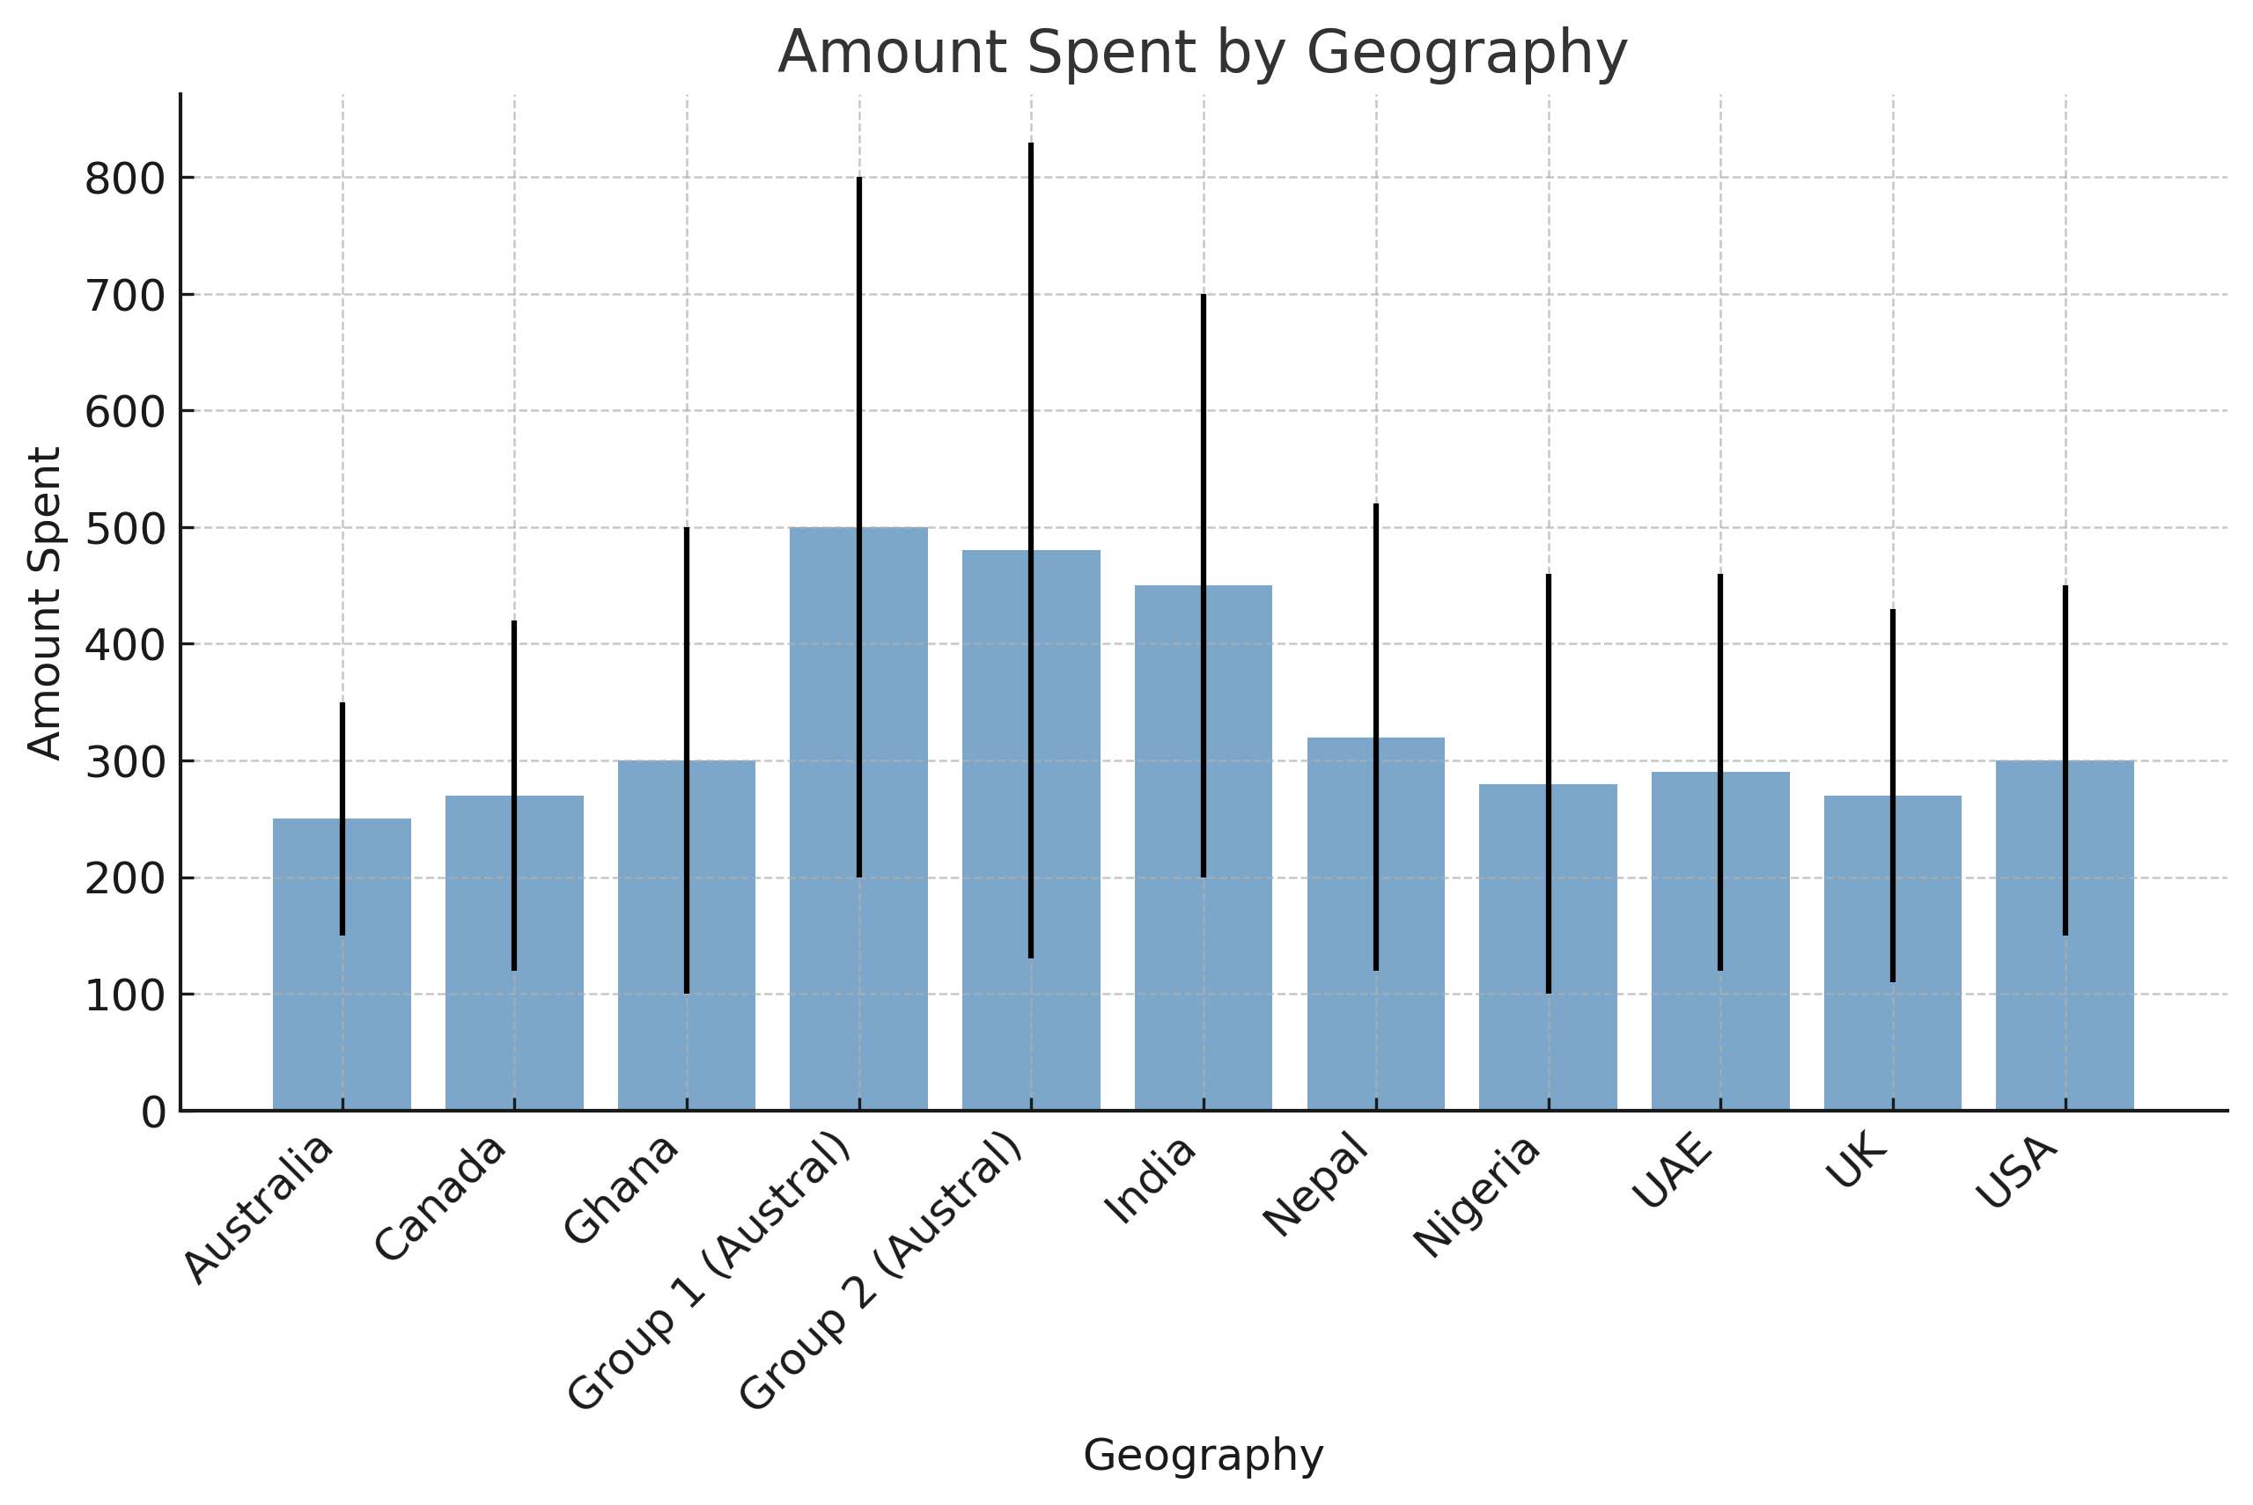
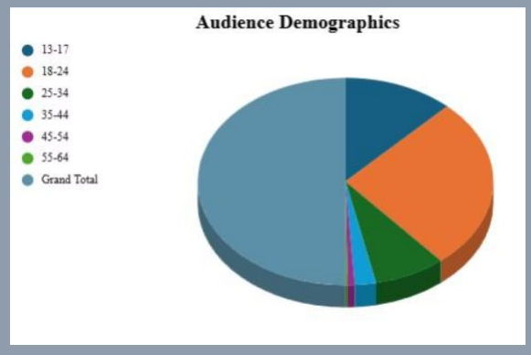
Audience Reach & Demographics
Amount Spent by Geography
Audience Demographics
Group1, Group2, India, and Nepal appear to have the highest spending.
Most Engaged Group: 18-24 Age Group
Least Engaged Group : 55-64 Age Group

Slide 9
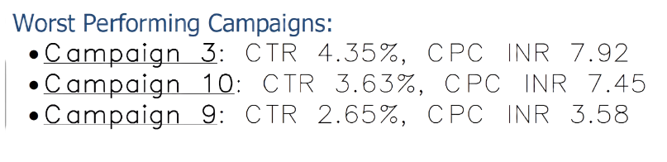
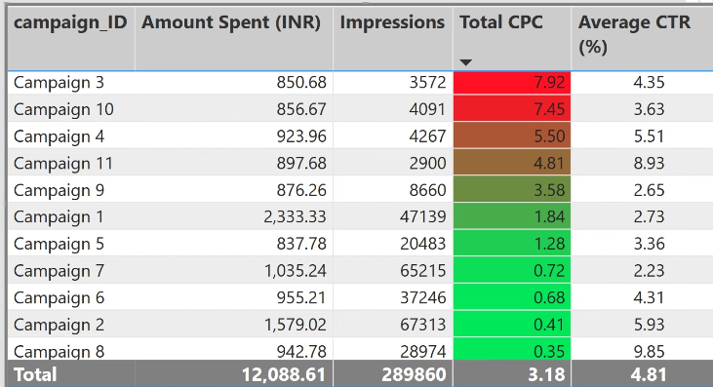
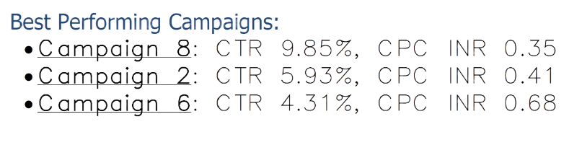
Campaign Performance Analysis

Slide 10




Conclusion:
Summary
Highest Reach
Campaign 8 is the most efficient; Campaign 3 needs to be Discontinued.
Group1, Group2, India and Nepal generated the highest reach.
1
2
ROI Analysis
4
3
High Engagement
Campaign 8 has the best ROI (Return on Investment)and should be prioritized.
The 18-24 age group shows the highest engagement across most campaigns.

Slide 11
Strategic Actions
Scale Up High-Performing Campaigns
Optimize Target Audience
Refine Ad Creatives & Messaging
Prioritize Campaign 8 and Campaign 11 as they have the highest CTR, allocate more budget and optimize ad creatives for these campaigns.
The 18-24 age group shows the highest engagement across campaigns.
Analyze high-performing campaigns to identify successful elements (copy, visuals, CTAs).
Discontinue or Optimize Low-Performing Campaigns
Budget Reallocation
Campaigns 3, 9 and 10 have the lowest CTR-making it inefficient and should either be discontinued or optimized with new creatives and better targeting.
Increase spending on Campaign 8, Campaign 2, and Campaign 6, which offer the best cost-effectiveness.

Slide 12
THANK YOU !
By, TEAM 29

